Slide 1

Python project : My first chatBot.
Arthur Donnat
Mathis Lemont
L1 int-1
group name : DONNAT-LEMONT-int1
2023
Efrei
1

Slide 2
Table of contents
1 : Cover page
2 : Table of contents
3 : Introduction
4 : Functional presentation
5 : Technical presentation
6 : Results presentation
7 : Conclusion
2

Slide 3
Introduction
presenting the project and its main objectives.
Create a chatbot that can answer to basics questions.
So for that, we want to manupilate .txt files, and do analysis and comparaison of words.
3

Slide 4
Functional presentation
Functionalities offered to the user:
o Name the functions realized among those proposed in the project.
o List the new proposed functions in addition to what was asked (if any).
4

Slide 5
Technical presentation
Explaining how the program achieves the different
proposed functionalities:
o Description of the main implemented algorithms (not to detail)
o Justification of the choice of data structures (list, dictionary, set, …) used.
o Presentation of the (technical) difficulties encountered and the solutions provided.
5

Slide 6
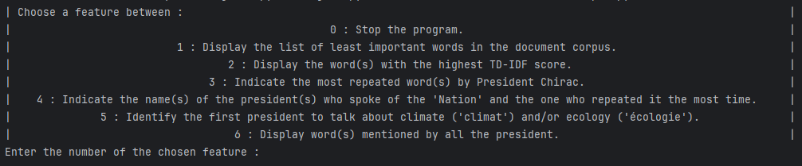

Results presentation
To start the code, run the main.py :
Now, enter the number corresponding to your chosen option.
For example, if you enter 2 :
6

Slide 7
Conclusion
Lessons learned from the project:
o Learning on the technical level
o Learning about work organization and communication within the team
o Learning about time management
o etc...
7

